Slide 1
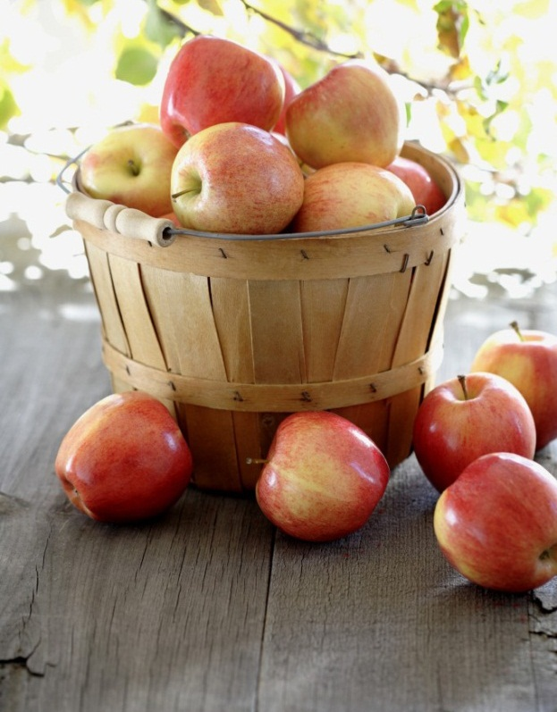

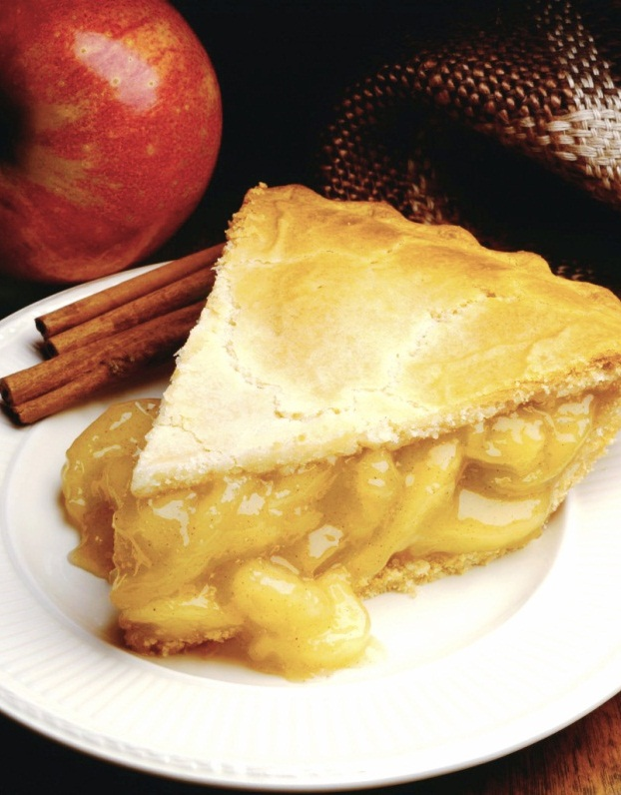
Cocktails & Cuisines
Presented to you by Foodie Friends
Thu Van Luu | Jessie Ng | Fraser Clarke | Aks Sreenivasan
Notes:
NOTE: To replace a picture, just select and delete it. Then use the Insert Picture icon to replace it with one of your own!

Slide 2
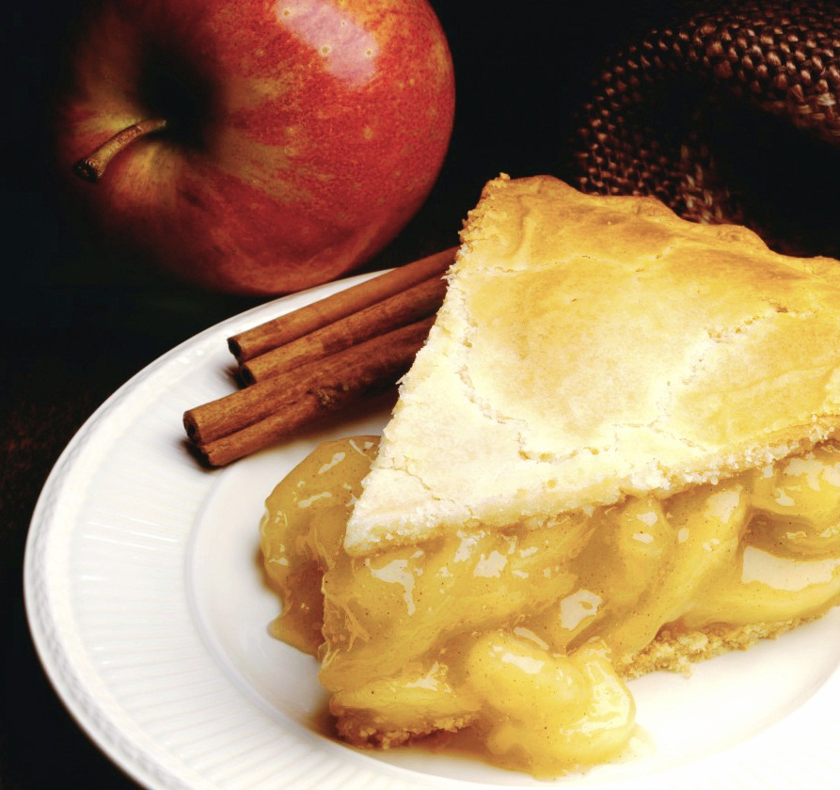
Elevator Pitch
“We’ve created an app which allows users to search for meal & cocktail recipes by name, presenting each result in an eye-catching and interactive accordion list.”

Slide 3
Concept
DESCRIPTION
An app that caters to the foodie and drinkie in all of us, we bring you a cookbook & mixer manual in digital form, allowing you to ‘thumb’ through and search an arsenal of recipes easily. ⋘ ────────────────────── ∗ ⋅◈⋅ ∗ ────────────────────── ⋙
USER STORY
AS A foodie / drinkie (ie. restaurateurs, chefs, bloggers)
I WANT to be able to search a meal or cocktail by name
SO THAT I can find recipes relating to the category I choose
MOTIVATION FOR DEVELOPMENT
Since foodies & drinkies are inclusive of people from all walks of life, our primary motivation was to build an app which would act as a ‘digital cookbook & drinkbook’ for our targeted audience.

Slide 4
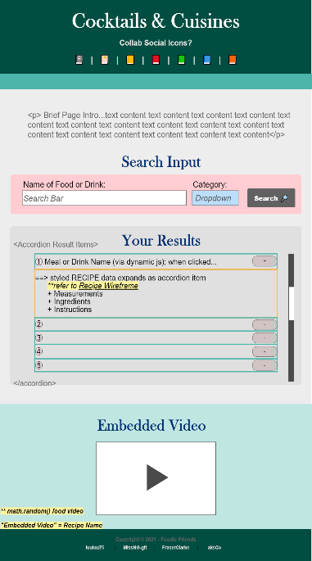
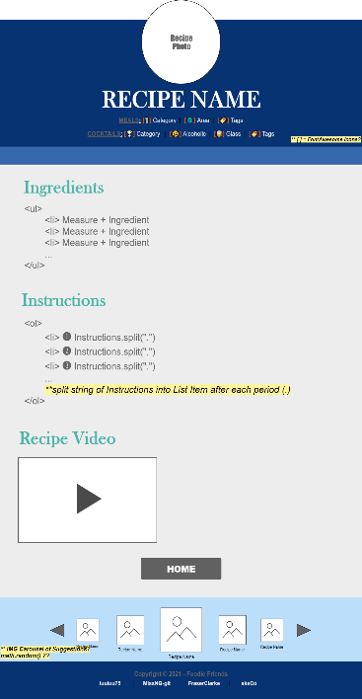
Process
Technologies used
GitHub
Local & Server-side APIs (x2) – MealDB & CocktailsDB
Foundation framework
HTML, CSS, Javascript w/jQuery
Challenges
Javascript
Foundation accordions
Utilising unfamiliar CSS framework
Navigating GitHub pulls, merges, etc.
Successes
Teamwork & Communication
Implement working accordion
Project implementation
Breakdown of tasks and roles
THU:
Project Manager
GitHub Setup &
HTML
Implementation of Foundation Framework
JESSIE:
Presentation
README
Wireframe Design
CSS Styling
FRASER: Javascript for Meals
AKS: Javascript for Cocktails

Slide 5
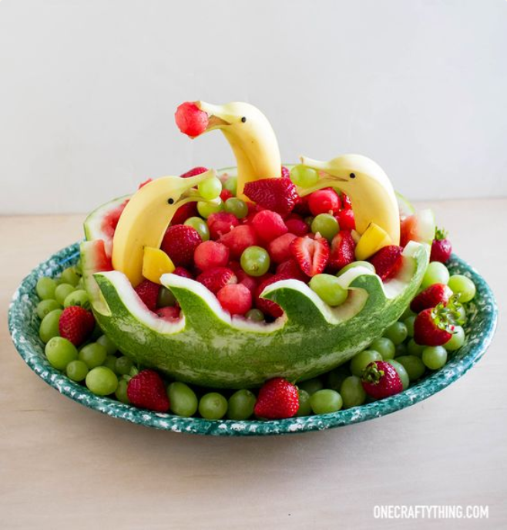
DEMO
Enjoy this first-look at the ‘fruits’ of our labor! 👀

Slide 6
Directions for Future Development
Implement interactive photo carousel above footer to display recipe suggestions
Add embedded video suggestion to home page
Turn instructions text into ordered list
Add ingredient & meal type (dinner, dessert, etc) search functionality as opposed to only searching by name
Incorporate modal when search bar or category is empty & user attempts search
Retain user’s last search results upon refresh using local storage

Slide 7
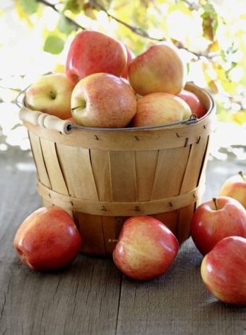
Links
Deployed Application
https://luuluu75.github.io//Cocktails-Cuisines/
GitHub Repository
https://github.com/luuluu75/Cocktails-Cuisines/

Slide 8

from Foodie Friends
Luuluu75 | MissNG-Git | FraserClarke | aksCo

